Slide 1
Clinical Change Project
Sarah Ashour

Slide 2
WHY:
To create a more thorough shift reporting system that will increase the patient’s health outcome and safety.
HOW:
Develop a standardized checklist utilized by unit nurses.
Clinical Change: Standardized Shift Report
WHO:
Internally initiated change by hospital unit manager.

Slide 3
NATIONAL SAFETY GOAL
National Patient Safety Goal #2: Improve staff communication.
For the patient:
The process will reduce the ‘alone’ time during shift change. Sentinel events also occur more often during this time.
This process will aid in increasing communication. Communication issues are the root cause of about 30% of patient safety events, and improved communication between caregivers greatly improves patient care and outcomes.
For the staff:
Ensures all pertinent information is communicated during shift reports.
Improves the sharing of information between health care providers by utilizing a standardized method of communicating.
Reminds nurses to reassess issues before coming on and off.
The off-going nurse can use “hands-on” to show the on-coming nurse how to operate special equipment or how special orders are being handled.
Accountability will increase since each nurse will know his or her patients’ condition at the end of the shift.
(Studer Group, 2009)

Slide 4
Definitions
Change: An alteration to make something different; a complex process that occurs over time and is influenced by any number of unpredictable variables
Planned Change: A process of intentional intervention to create something new. In general, it is a process by which new ideas or programs are created and developed, diffused through communication, intervention, and result in consequences of adoption or rejection.
Change Agents: A person or thing that produces a particular effect or change.
Change Agents in this Case: The nurses on the unit , because they are the ones who are implementing the change, which will produce the effect

Slide 5
Phases of Planned Change:
Lewin’s Change Process
Unfreezing: Assessing, problem identification, and definition
Refreezing: Evaluation, implementation, and evaluation
Moving:
Planning and implementing, Problem analysis and seeking alternatives
Lewin’s Change process was chosen because there was a problem that was identified and we used the process in order to find a solution, plan and implement change, and subsequently evaluate and implement the change.

Slide 6
Phases Cont’d
Unfreezing: Shift change is a very stressful time of the day. Information is not passed along, and the nurse that is giving report should be held accountable for what was expected of her during the day/night.
Moving: We will produce a report guidelines document that includes all of the information that should be passed along to the oncoming nurse during verbal report. There will also be a short checklist included on the patient assignment sheet that should be completed by both nurses at the patient’s bedside after verbal report is completed. This will also allow the oncoming nurse an opportunity to meet the patient, allow the patient to be more involved in their care, and provide verification for information given during report.
Refreezing: The change will be implemented and evaluated on both shifts to allow for a balanced result. In order to be able to evaluate the outcome an evaluation tool will be used to review the measurable differences in reducing errors and improving patient care that resulted from the implementation of the standardized report procedure.

Slide 7
Report guidelines
S Situation | Patient Problems
B Background | Admitting Diagnosis Admission Date Relevant Medical History Summary of treatment to date
A Assessment | Relevant Vital Signs Intake and Output Diet Pain Labs/tests IV fluids/medication drips Activity level/restrictions/isolation status/restraints Tubes/drains/surgical sites Changes from prior assessments→ neurological, GI/GU, cardiac, respiratory, musculoskeletal, integument, pain
R Recommendations | Pain management plan Discharge planning Needed tests/treatments Consultations Any other suggestions

Slide 8
Report Guidelines Cont’d
Verbal report: | Review of systems → organize head to toe Address abnormal issues If assessment reveals normal findings, simply state this State any changes that occurred during shift and any recommendations to the oncoming nurse
Change of shift chart checks: | Active patient orders in EMR Written orders in hard copy chart. Review orders specifically written within last 12 hours, and verify these have been transcribed into EMR Ensure all tasks from previous 12 hours are complete Check patient’s EMAR together to make sure medications are up-to-date, accurate, and all administered medications were charted
Bedside assessment & safety check: | Check patient identification and allergy bands, are they in place and accurate? Check IV fluids and infusing medications Check tubing for correct and up-to-date labels Check other equipment → suction, bag-mask, oxygen settings, PCA pumps, trach supplies, monitors, etc Evaluate patient to verify condition matches report Verify code sheet is attached to bedside chart, is up-to-date, and includes correct dosing weight Visually assess IV sites and dressings

Slide 9
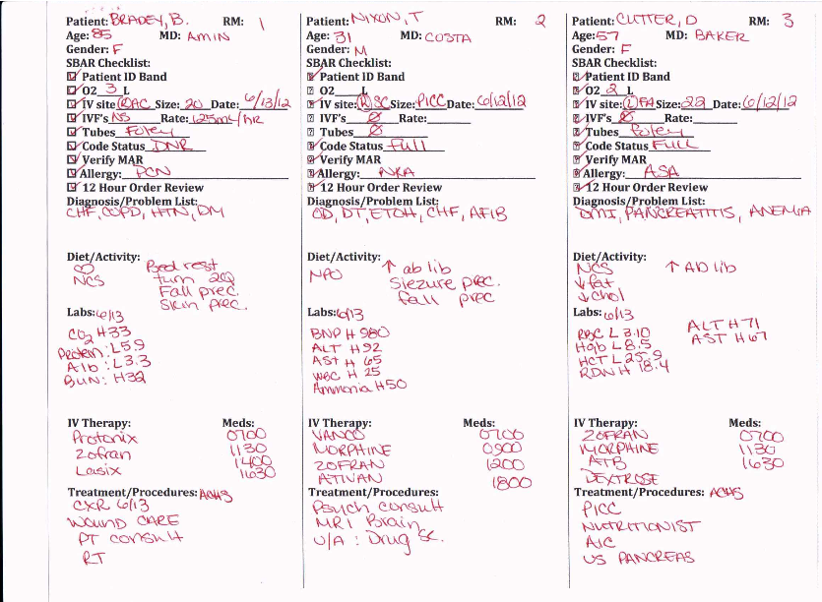

Slide 10
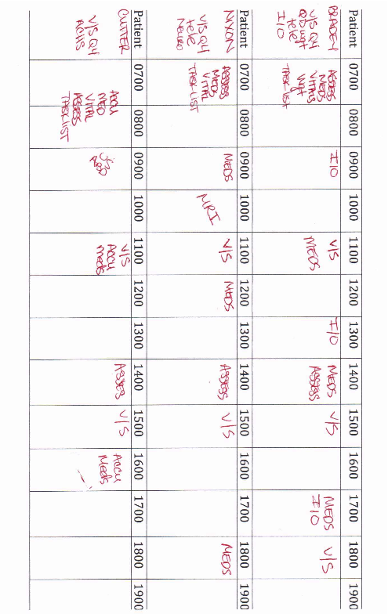

Slide 11
Stakeholders: Unit manager, unit nurses, patient care tech, patient and patient family
Communication Plan: Verbal communication, mass emails, unit rounds
Team Building: Staff input during meeting, staff involvement, physical presence
Identify the Stakeholders
Notes:
Bedside reporting WHAT NOT TO DO:
http://youtube/Pu2wwiUPWGo

Slide 12
Identify the stake holders Factors that predict successful change
Follow up- Timeline for intervention
Evaluation- Quality tracker dashboard
Relative advantage : The degree to which the change is thought to be better than the status quo – improvement of communication
Compatibility: The degree to which the change is compatible with existing values of the individuals or group-value patient safety
Complexity: the degree to which a change is perceived as difficult to use and understand- easy so more likely to succeed
Trialability: The degree to which a change can be tested out on a limited basis- holding trial on unit and if succeeds then other units will want to implement
Observability: the degree to which the results of a change are visible to others- reduction of medical errors and improvement of patient safety

Slide 13
Plan the Intervention Supplies, Personnel, & Budget
APPROXIMATE COST: $3,300-4,500
Supplies: $200
Paper
Copy Paper, 8 1/2" x 11", 20 Lb, 500 Sheets Per Ream, Case Of 10 Reams $39.99
Ink
Black Toner Cartridge, 7000 pages $157.99
Personnel: $3,000-4,200
RN $25/hr
Charge Nurse $30/hr
RN Manager $37/hr
Incentives: $100
Notes:
Approx. cost for month of implementation: 3,300 implement on day shift, 4,500 implement on night shift (shift differential), 7600 implement on both shifts (1 set of supplies sufficient for both shifts)
Does not include overhead (electricity, heating, internet, rent) costs
Personnel cost most variable
500 unallocated expenses (w/o= 6600 implement on both shifts)

Slide 14
TIMELINE FOR INTERVENTION
Week 1
Week 2
Week 3
Week 4
Week 5
Introduce new standardized reporting guidelines during staff meetings throughout the week
Review new report tools and discuss with staff so that procedure and staff expectations are understood
Communicate new guidelines for standardized reporting through email to unit staff
Encourage staff to use tools and begin process immediately through email and management rounds
Clinical leaders would make rounds during shift change to see/hear if new standardized reporting guidelines are being used
Speak with nurses about concerns/questions regarding new procedure
Communicate expectations for nurses through shift change and email
Staff should be fully implementing new guidelines
Clinical leaders should make rounds to see if this change is being implemented, and if family are being encouraged to sit in on report (if applicable)
Discuss new policy in this months staff meeting and make sure everyone has put it to use, and is now using it at every report/shift change/patient hand-off
Address any questions or concerns staff may have and allow time for feedback
Discuss the quality tracker to evaluate the effectiveness of the intervention
Discuss any improvements in unit as a result of new reporting guidelines (reduced errors, patient satisfaction, staff communication, patient identification)

Slide 15
Evaluation of Change
The Quality Tracker is the organizational tool for documenting assessment indicators and improvement indicators
The Quality Tracker Dashboard is used to collect and report indicator data monthly.
The Quality Tracker Action Plan is the tool that is used to document the improvement process.
Notes:
The Quality Tracker is the organizational tool for documenting assessment indicators (monitors to measure current process performance) and improvement indicators (measures that state the starting point for an improvement and a target/goal to be reached

Slide 16
Evaluation of Change Cont’d
What?
Using the ‘quality tracker dashboard’, the nurse manager will collect and document daily data related to medication errors, sentinel events, patient outcomes, and number of incidence reports.
‘Near misses, an event or error that had the potential to cause harm or reach a customer but was identified early enough in the process that it was avoided or corrected, will also be documented.
To make reporting as easy and as sufficient as possible, a safety line will also be established; the goal is to maintain a non-punitive reporting system where one can gather data to identify opportunities for continuous improvement before an error occurs.
‘Tracer’ visits will also take place, which will include observations of direct care, observation of medication process, observation of environment of care, as well as interdisciplinary team reviews and meetings.

Slide 17
Evaluation of Change Cont’d
How and When?
Using the quality tracker, information reported from months prior will be compared with data collected after the quality improvement plan has been established and taken place.
The quality tracker action plan will then be used to document the improvement process.
This action plan, as well as the quality tracker dashboard will be shared with employees on a regular basis in department meetings and through visual displays within the department.
Regular two-way communication and involvement of the frontline staff ensure the department is focusing on satisfying their customer needs.
This ensures expectations for continuous improvements.

Slide 18
QUESTIONS ?
THANK YOU

Slide 19
Resources
Huber, D. L. (2010). Leadership and nursing care management (4th ed.). Maryland Heights, MO: Saunders Elsevier.
Studer Group. (2009). Bedside report packet. Retrieved from http://www.studergroup.com/tools/bedside_shiftreport/BedsideReportPacket.pdf

