Slide 1
Family Centered Care
Kayla Barthle
Sarah Ashour
July 13, 2012

Slide 2
Assessment & Diagnosis
Lack of parent involvement noted in the NICU
Lack of communication between nurse and parents
Lack of unit resources related to parent support and involvement.
Need to recognize baby’s personal growth and development
Need to recognize parents as a large part of the patient’s journey

Slide 3
Identified QI
Measurable Outcome:
To increase family-centered care among patients to better improve their health care and outcome.
To reduce stress level and improve comfort and parenting confidence of NICU families.
Enhance the receptivity of NICU staff to the presence and benefits of family-centered care.
To enhance family and staff satisfaction in the NICU.

Slide 4
Planning
Develop tools to increase involvement with kangaroo care on the unit.
Provide parents with daily diary sheet to help them feel more involved in the care of their baby, as well as foster communication between the parents and nurse.
Develop a tool to help acknowledge baby’s developmental milestones while in the NICU.

Slide 5
Use of Evidence
“Family-centered care has been associated with numerous benefits including decreased length of stay, enhanced parent-infant attachment and bonding, improved well-being of pre-term infants, better mental health outcomes, better allocation of resources, decreased likelihood of lawsuits, and greater patient and family satisfaction” (Cooper, L., Gooding, J., Gallagher, J., Sternesky, L., Ledsky, R., & Berns, S, 2007).

Slide 6
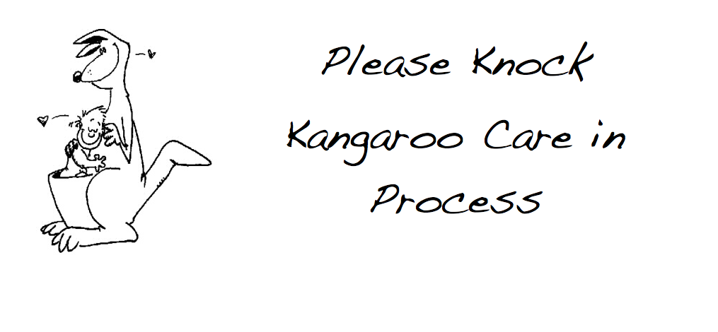
Kangaroo Care

Slide 7
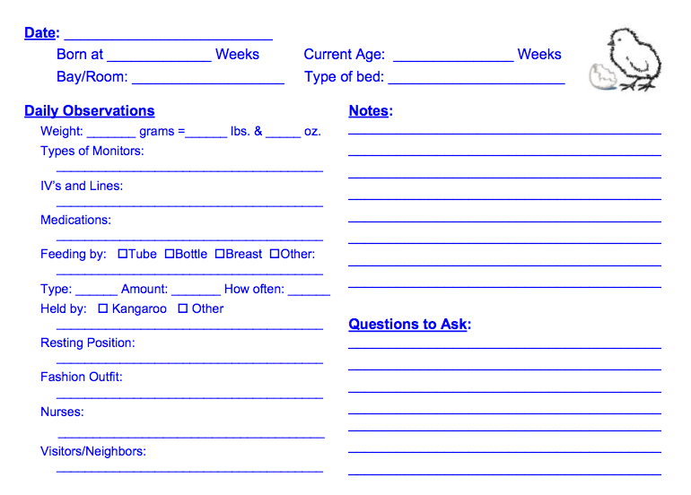
Parent Diary Sheet

Slide 8
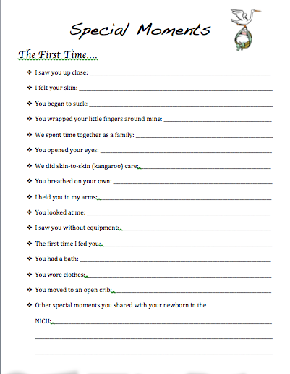
Baby’s Developmental Milestones

Slide 9
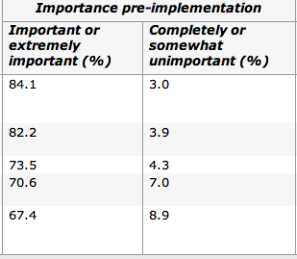
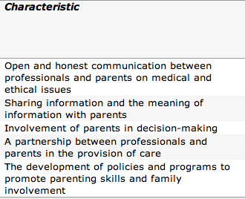
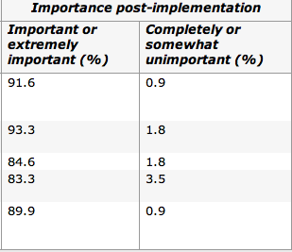
Data Analysis
Family-centered care characteristics and their importance in the NICU, pre- and post-implementation

Slide 10
IMPLEMENTATION
This project will be presented to a couple nurses on the NICU floor in hopes of promoting family-centered care on the unit.
We will explain all the tools we developed for the project, including kangaroo care-made blankets & privacy signs for the doors for parents. In addition, we plan to promote the use of kangaroo care.
We will also explain to nurses how to use baby milestone sheets to celebrate baby’s special moments in care, as well as the use of parent daily diary sheets.
These sheets will be printed out and put into a folder to allow nurses to implement them on the unit. Kangaroo care blankets will also be left for use as a resource to parents.

Slide 11
Evaluation
Staff Survey
Parent Survey

Slide 12
References
Cooper, L., Gooding, J., Gallagher, J., Sternesky, L., Ledsky, R., & Berns, S. (2007). Impact of a family-centered care initiative on NICU care, staff and families. Journal Of Perinatology, 27S32-7. Retrieved from http://search.ebscohost.com/login.aspx?direct=true&db=cin20&AN=2009751466&site=ehost-live
Kearvell, H., & Grant, J. (2010). Getting connected: How nurses can support mother/infant attachment in the neonatal intensive care unit. Australian Journal Of Advanced Nursing, 27(3), 75-82. Retrieved from http://search.ebscohost.com/login.aspx?direct=true&db=a2h&AN=49240736&site=ehost-live
http://www.nann.org/uploads/NICUjournal2010.pdf
http://ipfcc.org/advance/Checklist_for_Attitudes.pdf
https://org2.democracyinaction.org/o/6739/images/fcca_FamilyTool.pdf

